Slide 1
I/O Devices & Components of a computer
Lecture 2

Slide 2
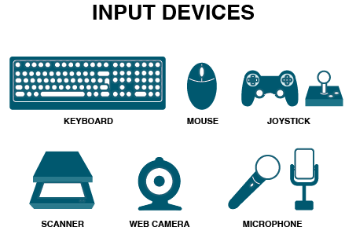
INPUT DEVICES
An input device is used to get data or instructions from the user. This data is then
passed on to CPU for processing so as to produce the desired result.

Slide 3
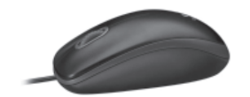
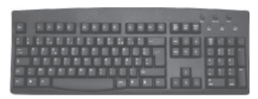
INPUT DEVICES
Keyboard:
The keyboard is very much like a standard typewriter with a few additional keys.
Generally, we find a QWERTY keyboard with 104 keys on it. The additional keys may be included in modern multimedia keyboards.
Mouse:
It is basically a pointing device that controls the movement of the cursor or pointer on a display screen. It is a small object that you can roll along a hard and flat surface. As you move the mouse, the pointer on the display screen moves in the same direction.

Slide 4
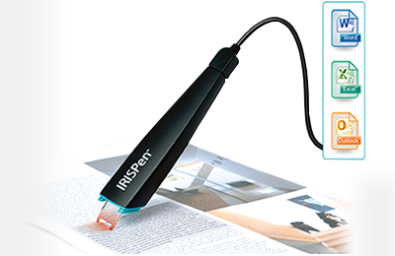
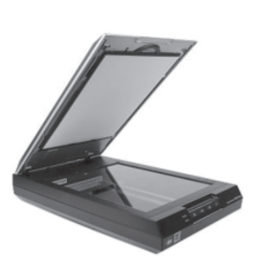
INPUT DEVICES
Scanner:
Scanner is an input device that can read text or an illustration printed on paper and translates the information into a form that the computer can use. A scanner works by digitizing an image - dividing it into a grid of boxes and representing each box with either a zero or a one, depending on whether the box is filled in.
Optical Character Recognition (OCR):
An Optical Character Recognition (OCR) is a device that is used for reading text from paper and translating the images into a form that the computer can understand. An OCR is used to convert books, magazines and other such printed information into digital form.

Slide 5
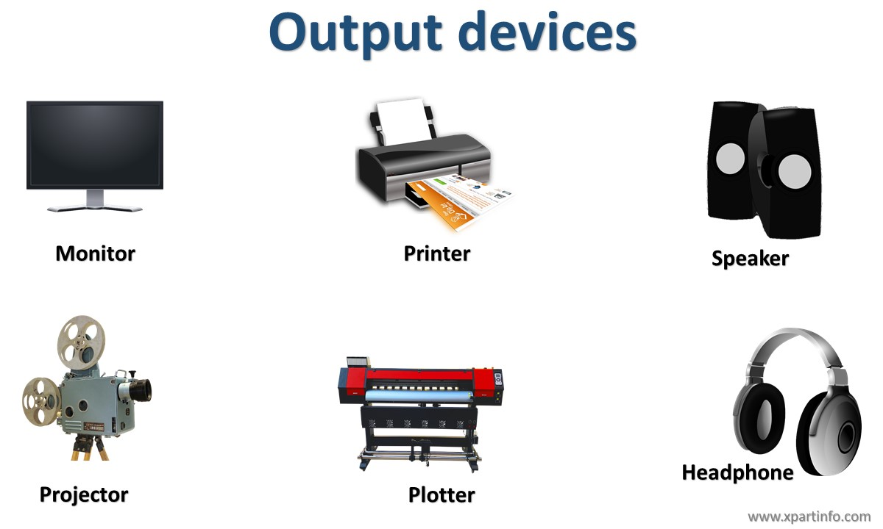
OUTPUT DEVICES
Output devices receive information from the CPU and present it to the user in the
desired form. Some of the output devices are monitor, printers, plotters, etc.

Slide 6
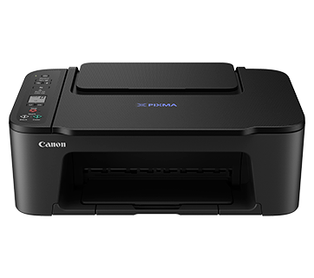
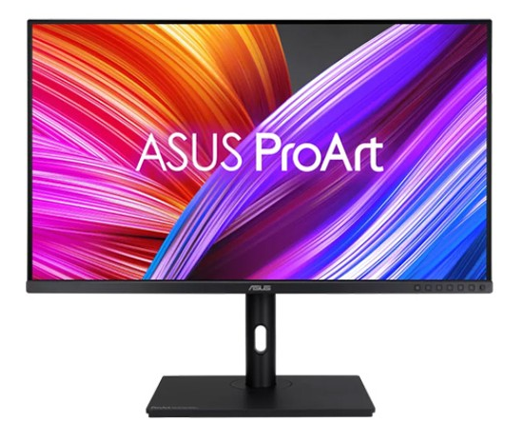
OUTPUT DEVICES
Monitor:
The monitor is just like a television screen and it is used to display data and information. When some data or instruction is being keyed in, the monitor displays the characters being typed..
Printer:
You must have used printer for taking printouts. Printer is a device that produces the output on paper. Such an output is also known as hard copy and it may be in the form of text or graphics.

Slide 7
Home Task:
List out different types of I/O devices and write down about them

Slide 8
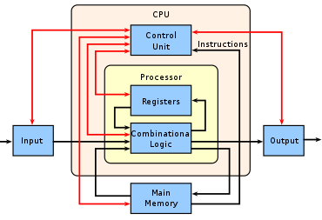
CENTRAL PROCESSING UNIT (CPU)
CPU is the ‘Brain of your computer’. This is because it processes or executes the instructions given to the computer. In a microcomputer, the CPU is based on a single chip called the microprocessor.
A typical CPU has the following components:
Control Unit (CU)
Arithmetic Logic Unit (ALU)
Memory Registers

Slide 9
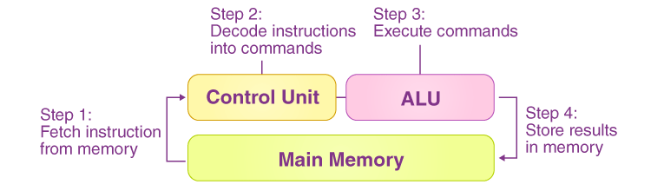
Control Unit (CU)
The Control unit manages the instructions given to the computer. It coordinates the activities of all the other units in the system by instructing rest of the components of the computer about how to carry out a program’s instructions. It reads and interprets instructions from memory and transforms them in to series of signals to be executed or stored. It also directs the movement of these electronic signals between memory and ALU or between CPU and input/output devices.

Slide 10
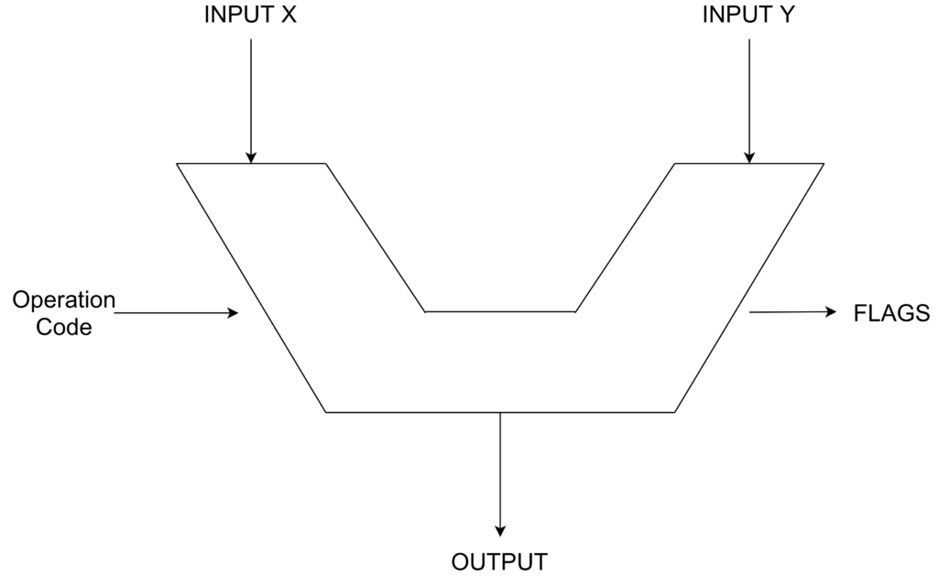
Arithmetic Logic Unit (ALU)
Arithmetic Logic Unit or ALU performs two types of operations - arithmetic and logical. Arithmetic operations are the fundamental mathematical operations consisting of addition, subtraction, multiplication and shifting operations. Logical operations consist of boolean comparisons such as AND, OR and NOT.

Slide 11
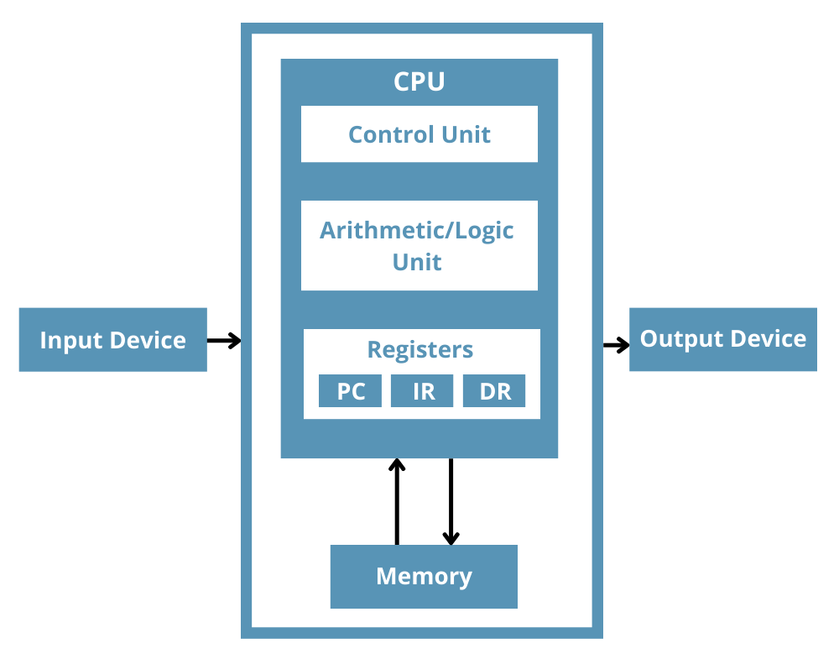
Memory Registers
A memory register is a sort of special storage area that holds the data and instructions temporarily during processing. Since this is internally located in the CPU, the processing time is very less. They often hold data for less than a millisecond. This high speed storage area make processing more efficient.

Slide 12
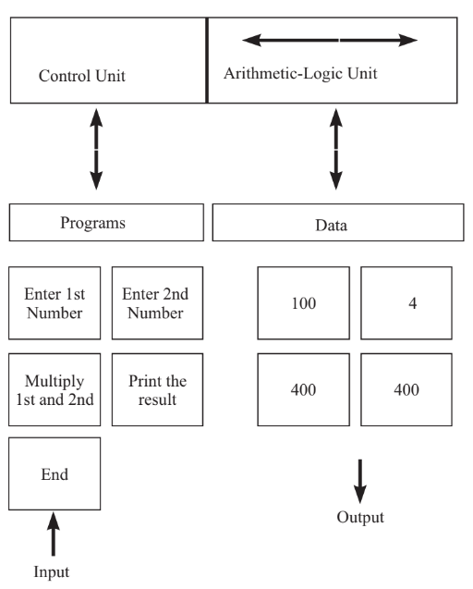
How the CPU and Memory work together?

Slide 13
That’s all for today….. See you in next class

